Slide 1

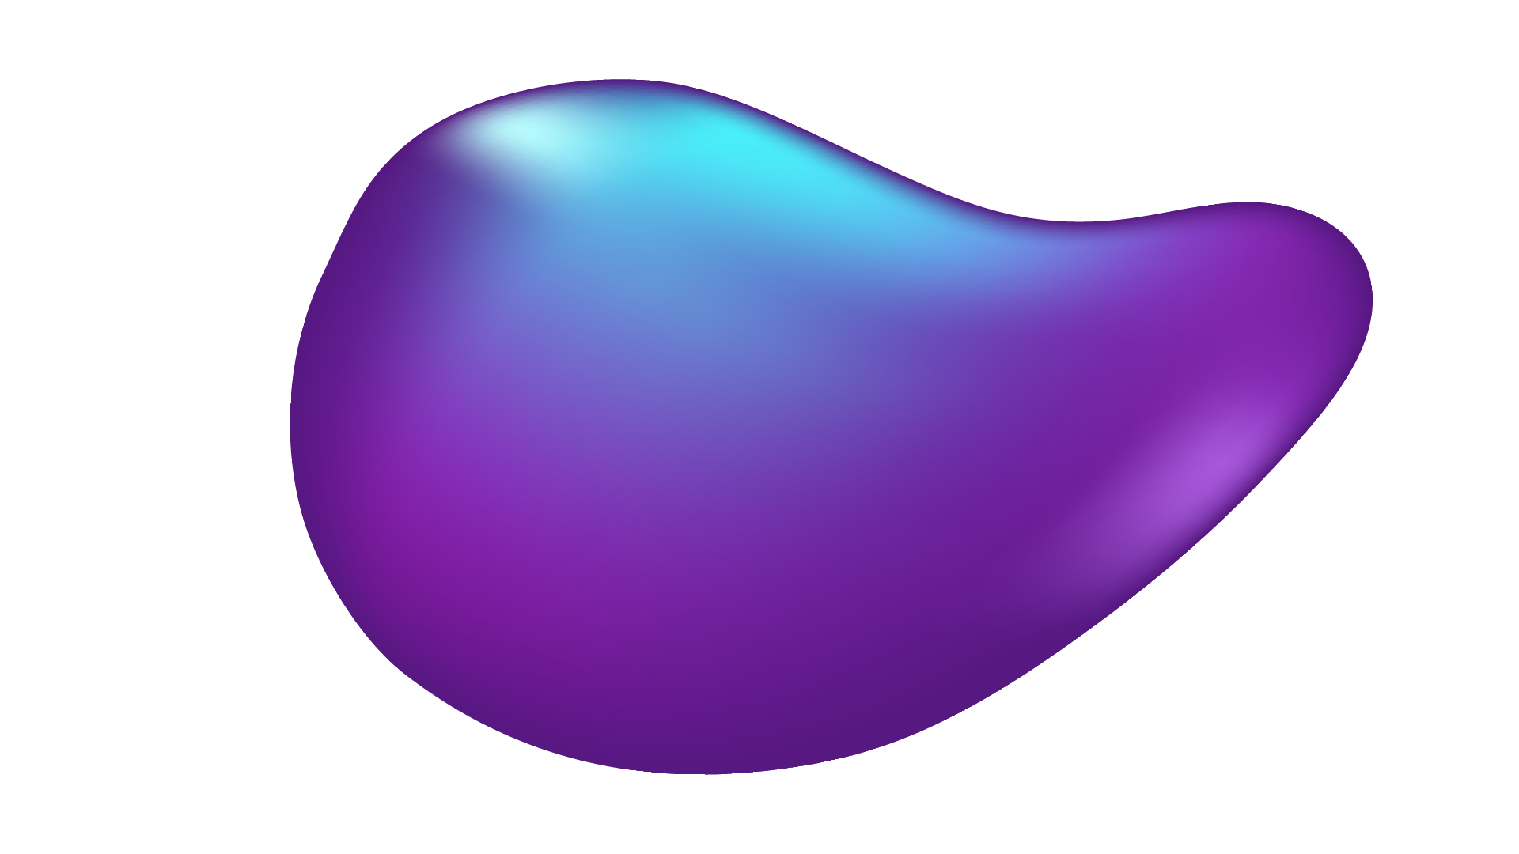
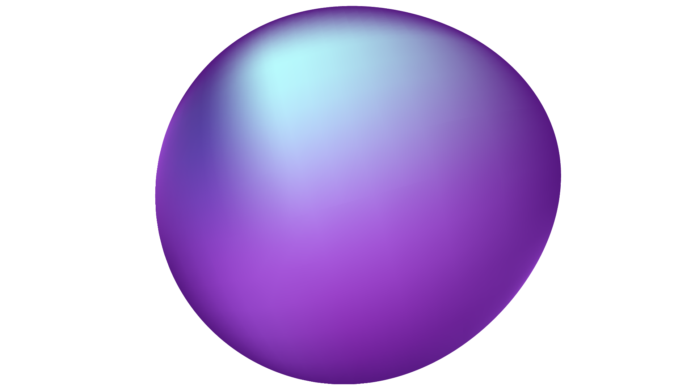
Data Science
Project
Lab Group: c133
Group members
O jing ( U2223350G )
MANI SENTHILNATHAN VIGNESH ( U2221484L )
RIDHWAN HAKIM ( U2223412E )

Slide 2
TABLE OF CONTENTS
01
02
03
04
INTRODUCTION
EDA & DATA PREPARATION
MODELS & METHODOLOGY
CONCLUSION

Slide 3
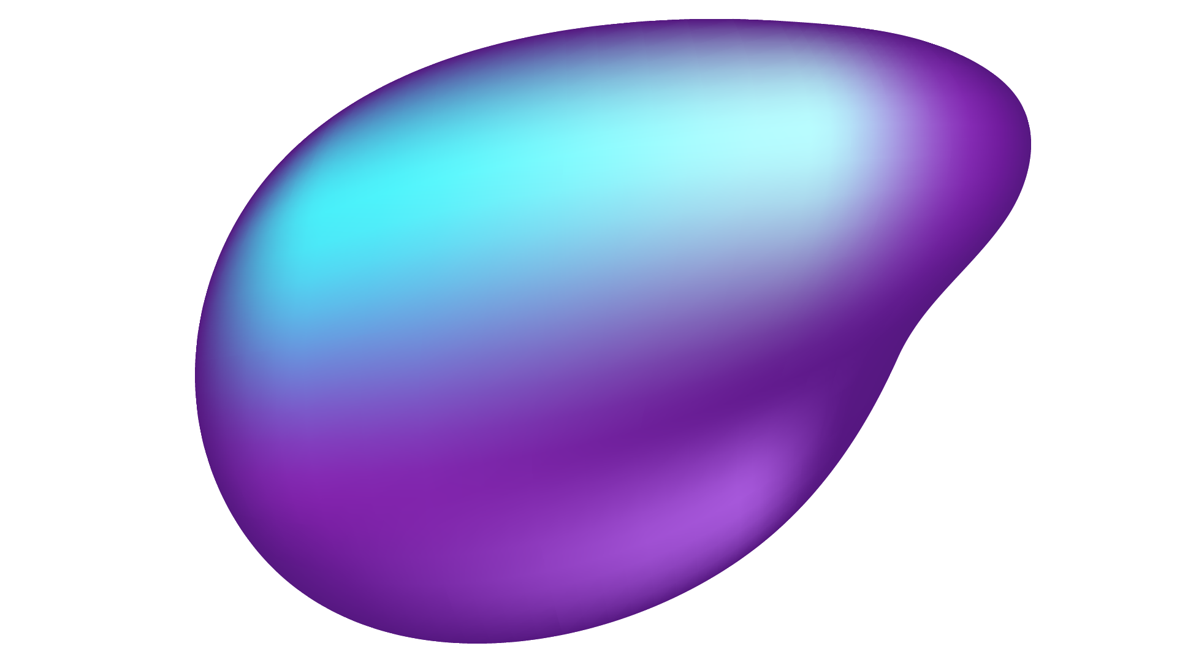
01
INTRODUCTION

Slide 4

INTRODUCTION
34
One person dies of heart related illnesses every 34 seconds
Heart disease is the leading cause of death for men, women, and people of most racial and ethnic groups in the US.

Slide 5
PROBLEM STATEMENT
“Discovering the key features or symptoms that determine the patient's likelihood of heart diseases”

Slide 6
WHAT ARE WE WORKING ON?
INVALUABLE
FOCUS
EARLY DETECTION
Would greatly assist healthcare professionals in their diagnosis
Allows greater focus on the symptoms and factors that actually matter
Illnesses can be detected earlier and medical costs can be saved

Slide 7
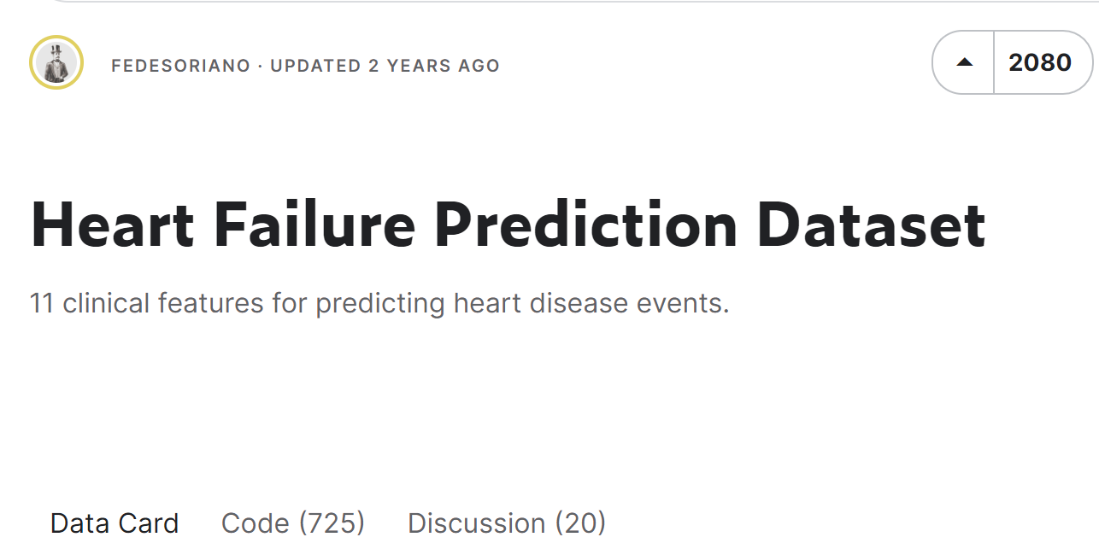
INTRODUCTION
Data set taken from Kaggle by user FEDESORIANO
This dataset was created by combining different datasets already available
11 common features were identified, making it the largest heart disease dataset available so far for research purposes.
Final dataset: 918 observations

Slide 8
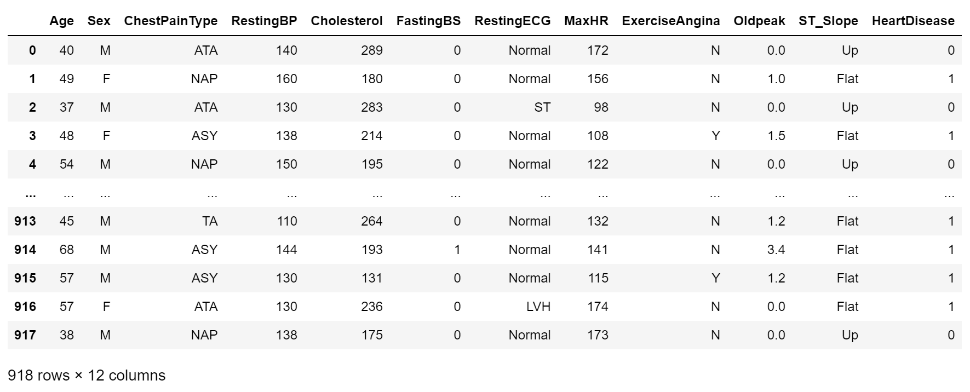
01 INTRODUCTION
From kaggle

Slide 9
OUR CATEGORICAL VARIABLES
SEX
FASTING BS
CHEST PAIN TYPE
[TA: Typical Angina]
[ATA: Atypical Angina]
[NAP: Non-Anginal Pain]
[ASY: Asymptomatic]
[M: Male]
[F: Female]
[1: if FastingBS > 120 mg/dl]
[0: otherwise]
ST_SLOPE
RESTING ECG
EXERCISE ANGINA
[Normal: Normal]
[ST: having ST-T wave abnormality]
[LVH: showing probable or definite left ventricular hypertrophy]
[Y: Yes]
[N: No]
[Up: upsloping]
[Flat: flat]
[Down: downsloping]

Slide 10
OUR NUMERICAL VARIABLES
AGE
MAXHR
RESTING BS
Age of the Patient
[years]
Maximum Heart Rate Achieved [Numeric value between 60 and 202]
Resting Blood Pressure
[mm Hg]
CHOLESTEROL
OLDPEAK
RESPONSE VARIABLE
serum cholesterol [mm/dl]
HEART DISEASE
ST [Numeric value measured in depression]
[1: heart disease]
[0: Normal]

Slide 11

02
EDA & Data Preparation

Slide 12
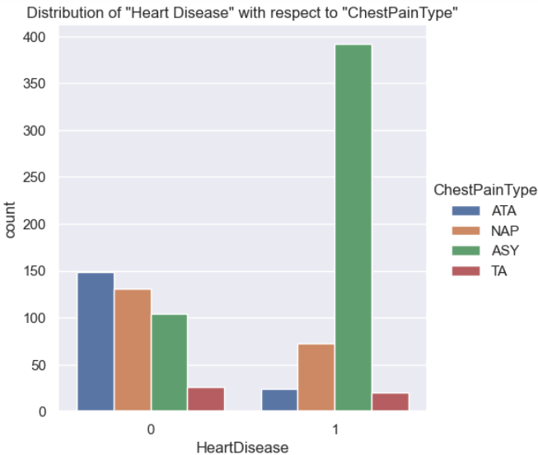
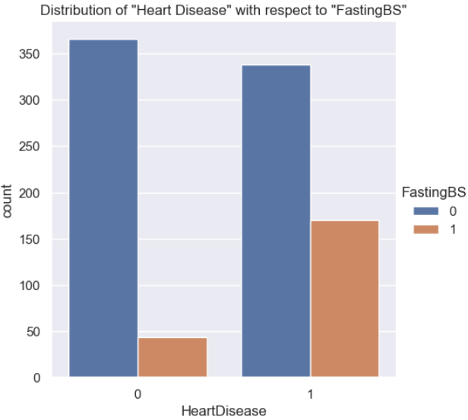
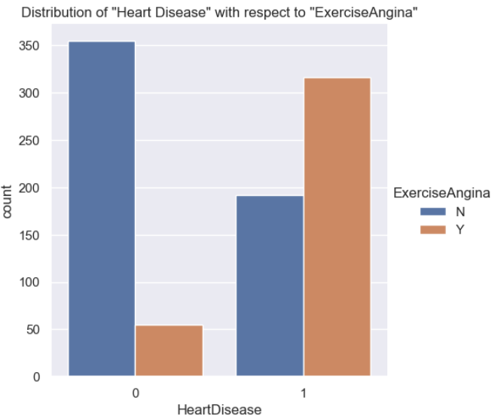
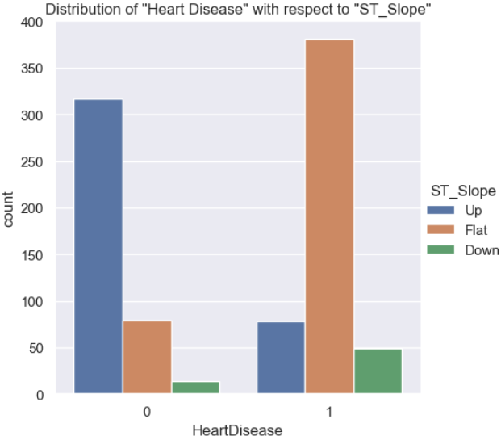
Observing Distribution of Categorical values
Most likely to get Heart Disease:
Chest Pain Type: ASY
Fasting BS: >120 mg/dl
Exercise Angina: Yes
ST_Slope: Up
Notes:
We will will take note of these variables in the following sections.

Slide 13
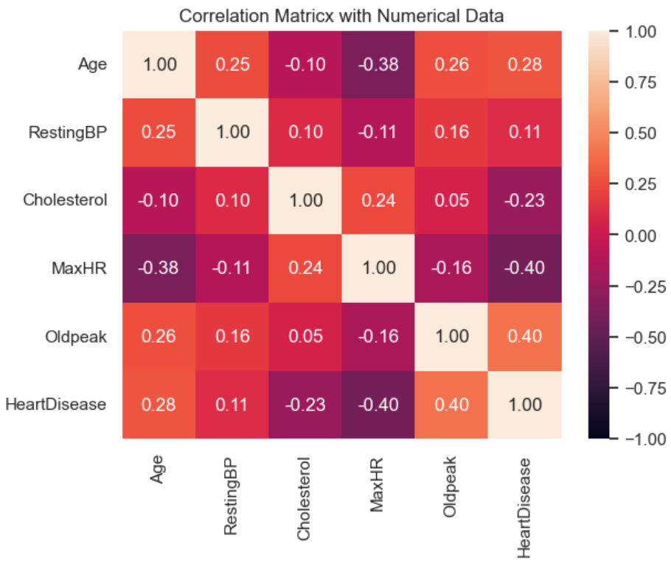
EDA - Numerical values
Numerical data correlation with
“Heart Disease”
Oldpeak: 0.4
MaxHR: -0.4
Age: 0.28
Cholesterol: -0.23
RestingBP: 0.11

Slide 14
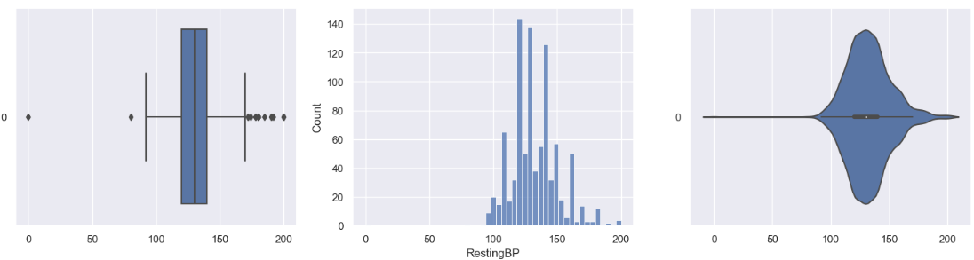
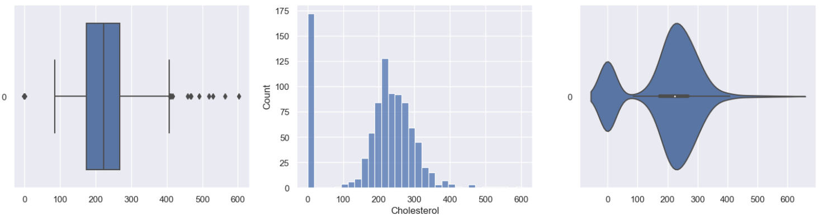
Observing Distribution of Numerical Values
Presence of Outliers and “Missing values” (imputed with “0”)
Resting BP:
Outliers: 28
Missing Values: 1
Cholesterol:
Outliers: 183
Missing Values: 172

Slide 15
DATA PREPARATION
IMPUTATION
OUTLIER REMOVAL
DROPPING MISSING VALUES
Imputed “missing values” with Mean/Median values
Removing outliers that skew distribution
Dropping rows which contain “missing values”

Slide 16
Data Preparation - Data Cleaning
RestingBP
Removal of Outliers
Dropping 1 “Missing Value” Row
Oldpeak
Removal of Outliers
MaxHR
Removal of Outliers

Slide 17
Data Preparation - Data Cleaning
Cholesterol
Zero Imputation with Outliers (No change)
Mean Imputation with Outliers (Mean Imputation)
Median Imputation with Outliers (Median Imputation)
Zero Imputation without Outliers (Removal of Outliers)
Mean Imputation without Outliers (Removal of Outliers)
Median Imputation without Outliers (Removal of Outliers)

Slide 18
6 PRONGED APPROACH
ATTEMPT 1
ATTEMPT 2
ATTEMPT 3
Zero Imputation with Outliers [IPzero_heart_df]
Mean Imputation with Outliers [IPmean_heart_df]
Median Imputation with Outliers [IPmedian_heart_df]
ATTEMPT 4
ATTEMPT 5
ATTEMPT 6
Zero Imputation with Outliers [IPzero_N0_outliers_heart_df]
Mean Imputation with Outliers [IPzero_N0_outliers_heart_df]
Median Imputation with Outliers [IPzero_N0_outliers_heart_df]

Slide 19
03
Model Selection

Slide 20
Model Selection
Binary Classification
Classification Models
Predict likelihood of heart disease based on predictor variables
Decision Tree (Baseline Model)
Random Forest
Logistic Regression
State Vector Machine (SVM)

Slide 21
04
Decision Tree

Slide 22
DECISION TREE MODEL
INTERPRETABILITY
NON-PARAMETRIC
Easy to understand and interpret
through tree diagrams
Does not make any assumptions about the distribution of data or the relationship between features

Slide 23
WHAT DOES THE MODEL DO?
INPUT
OUTPUT
6 Datasets with varying Imputation and Outlier presence
Classification Report
(Recall, Precision, F1-Score)
HYPERPARAMETERS
THE PROCESS
Maximum Depth of Tree
Recursively splits the data into subsets based on the most significant feature until a decision is reached

Slide 24
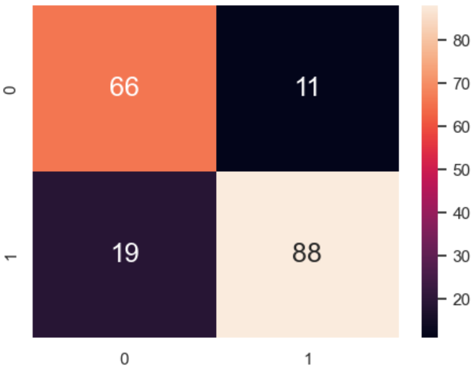
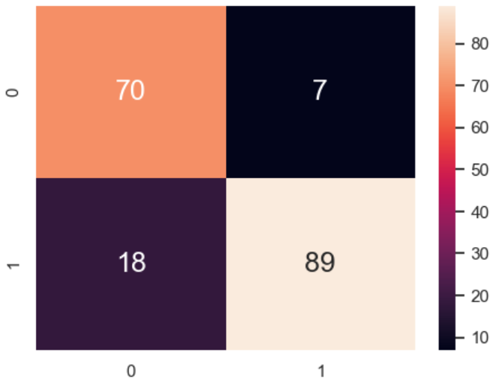
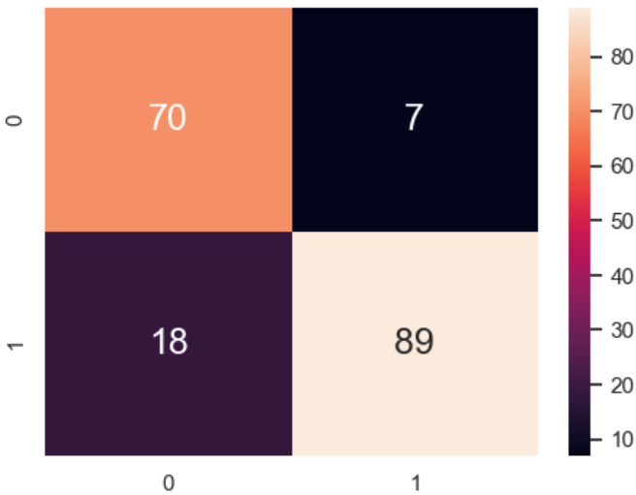
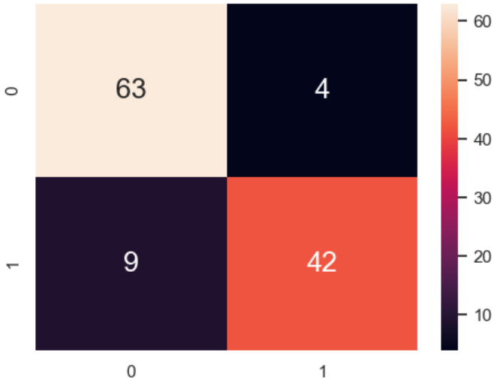
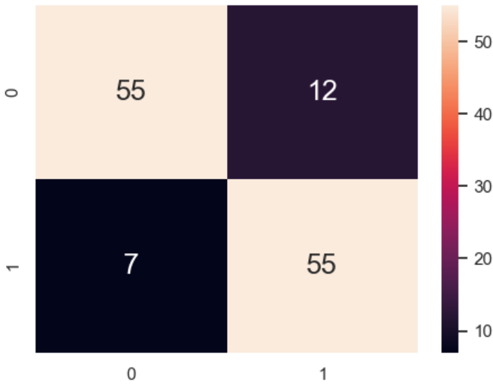
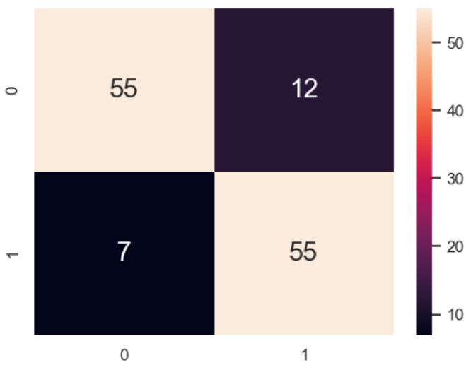
6 Datasets, GridSearchCV
Model 1 (Zero)
Model 2 (Mean)
Model 3 (Median)
Model 4 (Zero no outliers)
Model 5 (Mean no outliers)
Model 6 (Median no outliers)

Slide 25
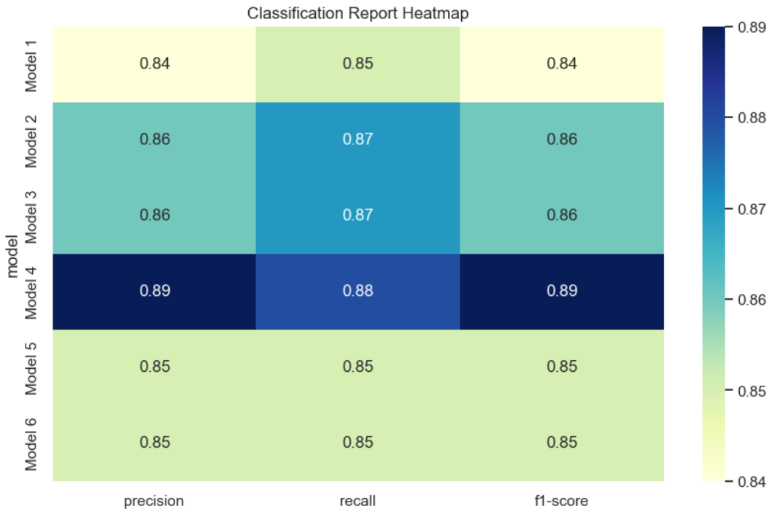
FINDING THE BEST MODEL
Print the macro average metrics for the test dataset in a heatmap
Mean and median imputation has higher scores than zero imputation
Imputing missing values with mean median can improve performance
Removing outliers can be more effective in improving accuracy
Model 4 (zero imputation, no outlier) has the highest scores among all models

Slide 26
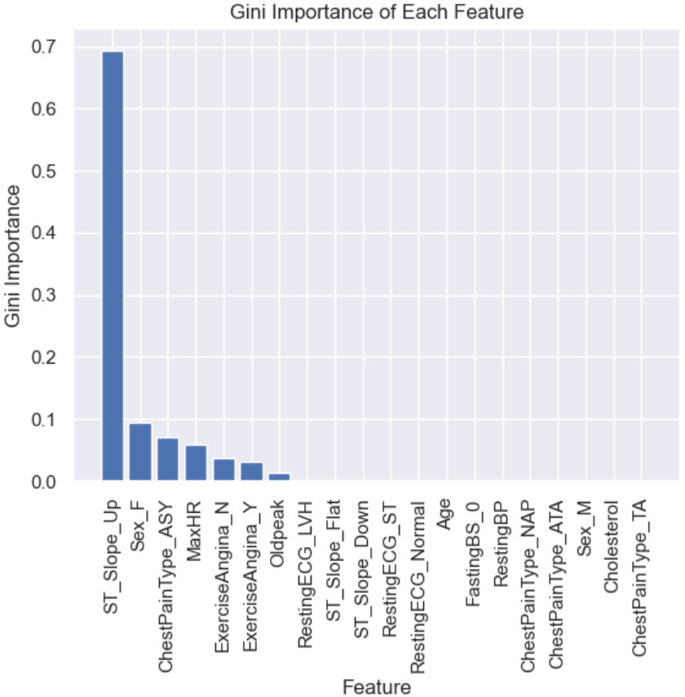
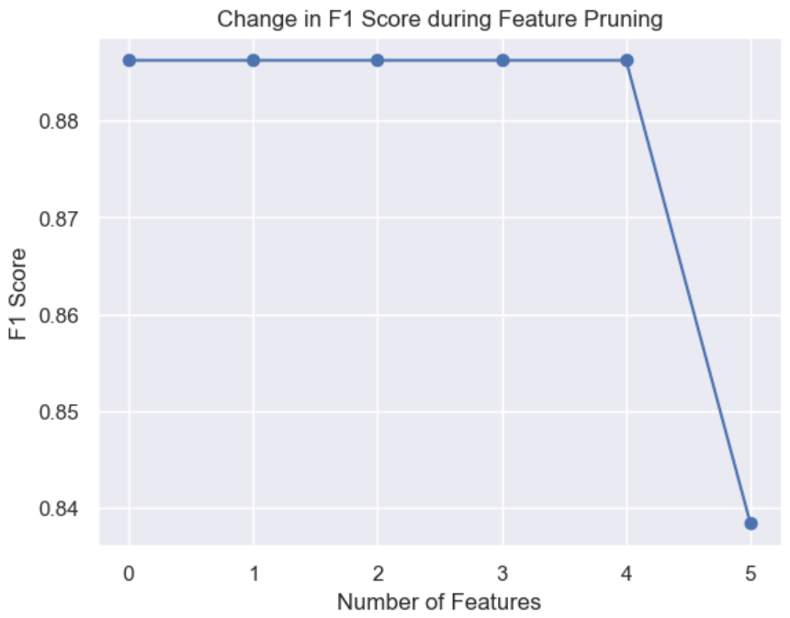
FEATURE PRUNING
Used to remove irrelevant or redundant input features, improving model efficiency and accuracy.
Remove all features with a Gini importance of 0.
Prune the features one by one until there are only 3 features left
Steep degradation in F1 score after removing “MaxHR” feature
Important Features:
MaxHR
ChestPainType_ASY
Sex_F
ST_Slope_Up

Slide 27
05
Random Forest

Slide 28
RANDOM FOREST MODEL
REDUCED OVERFITTING
IMPROVED ACCURACY
Introducing randomness into the construction of decision trees.
Uses multiple trees to make predictions
ROBUSTNESS TO OUTLIERS
VARIABLE IMPORTANCE
Aggregate predictions of multiple trees rather than single tree that may be highly influenced by outliers
Useful for feature selection and interpretation.

Slide 29
WHAT DOES THE MODEL DO?
INPUT
OUTPUT
6 Datasets with varying Imputation and Outlier presence
Classification Report
(Recall, Precision, F1-Score)
HYPERPARAMETERS
The process
Number of Trees in Forest
Max Depth of Tree
Random Forest Model constructs multiple decision trees.

Slide 30
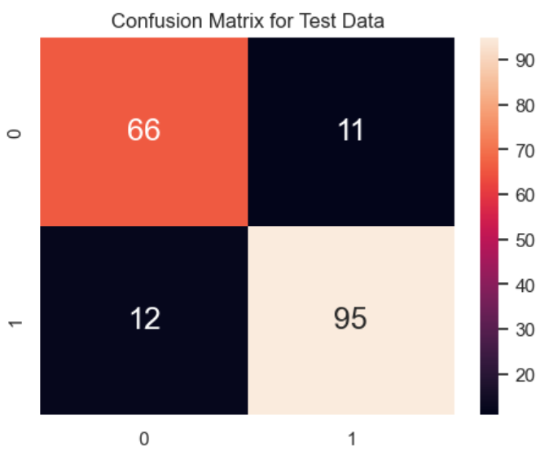

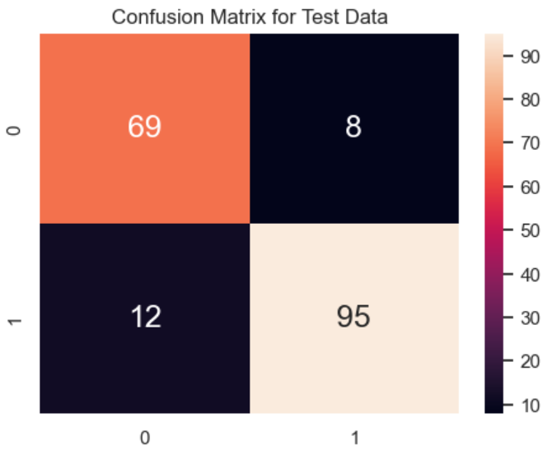
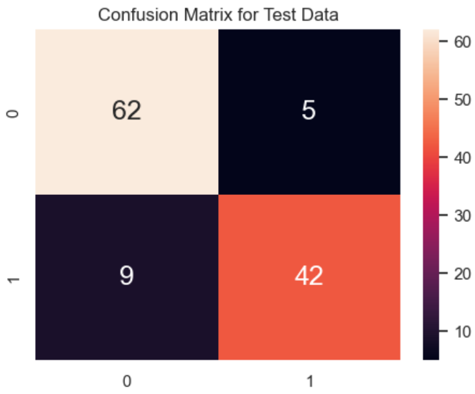
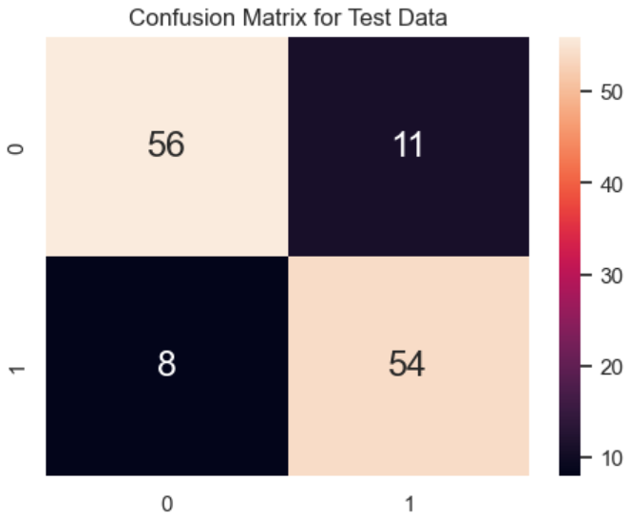
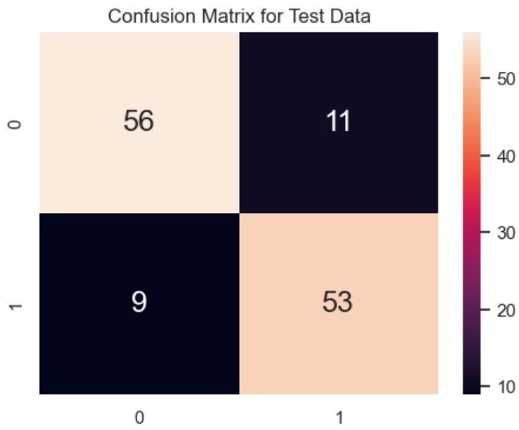
6 MODELS
Model 1 (Zero)
Model 2 (Mean)
Model 3 (Median)
Model 4 (Zero no outliers)
Model 5 (Mean no outliers)
Model 6 (Median no outliers)

Slide 31
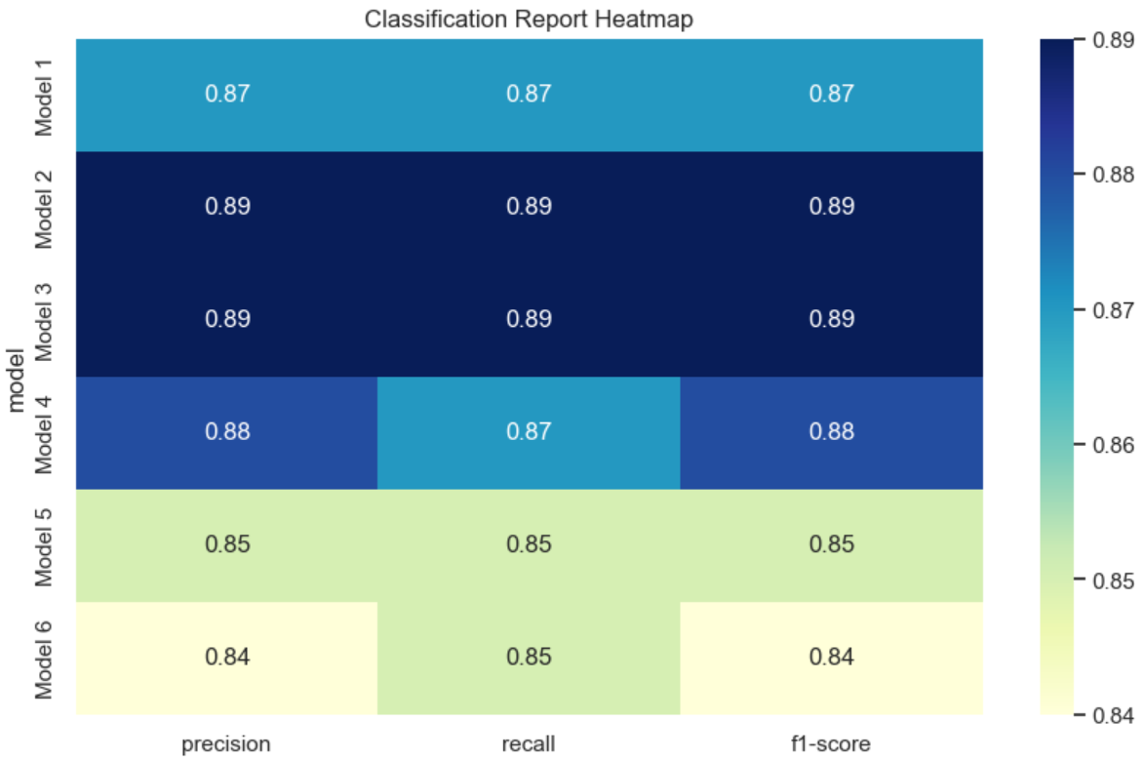
FINDING THE BEST MODEL
Print the macro average metrics for the test dataset in a heatmap
Models 2 and 3 has the highest and same classification report scores
Mean and median imputation with outliers can have a significant impact on accuracy
Zero imputation (with and without outliers) may not be as effective
Removal of outliers in mean and median may not be as effective
Attempt learning curve technique to pick best model out of Models 2 and 3

Slide 32
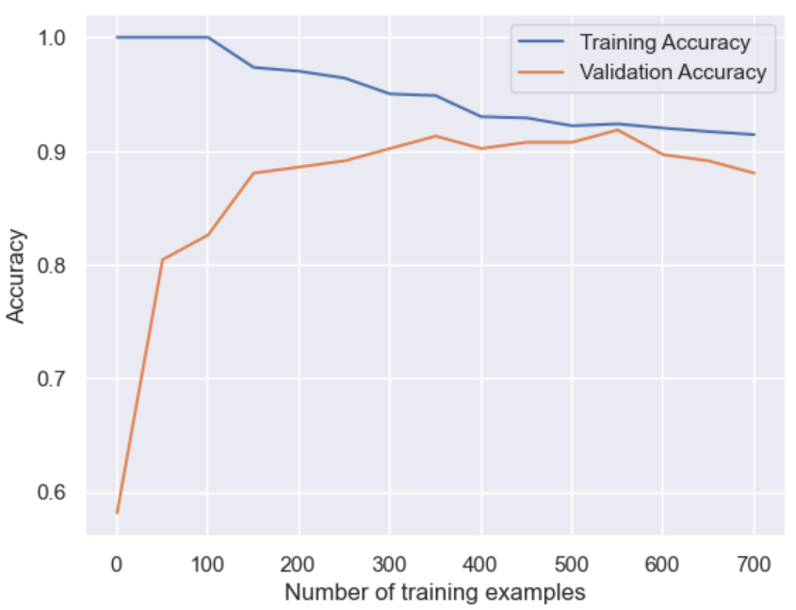
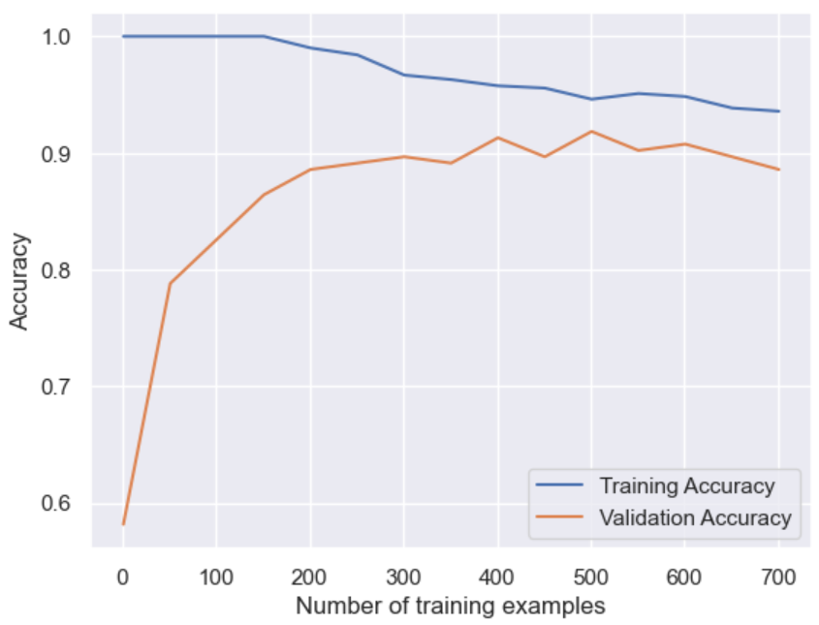
Learning Curve
Graphical representation of the performance of a model as it learns from training data, plotting the model's error or accuracy as a function of the amount of training data used.
Comparing the validation accuracy at different points of training examples, Model 3 performs better than Model 2
MODEL 2
Mean Imputation with outliers
MODEL 3
Median Imputation with outliers

Slide 33
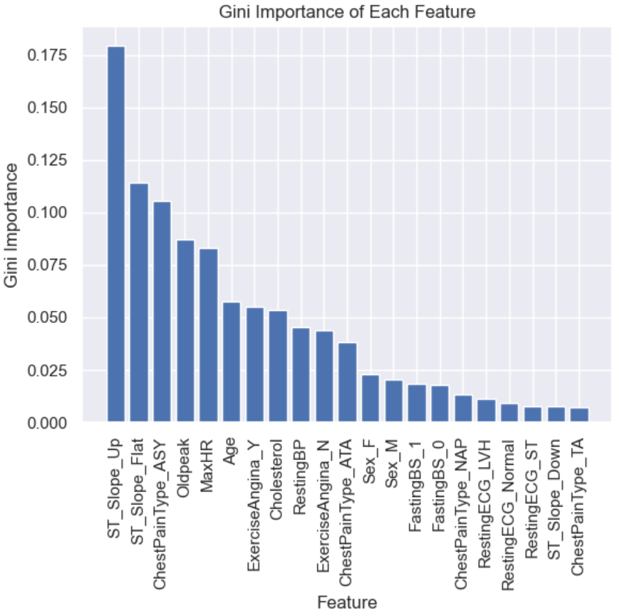
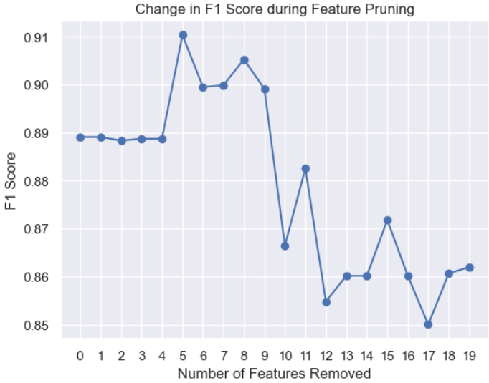
FEATURE PRUNING
RestingECG_Normal (4th removed feature) significant rise in F1 score.
Sex_M (9th removed feature) significant drop in F1 score.
Sex_F (10th removed feature) significant rise in F1 score.
ChestPainType_ATA (11th removed feature) significant drop in F1 score.
This leaves us with 3 other features, namely ChestPainType_ASY, ST_Slope_Flat and ST_Slope_Up which still remain unremoved.
Important Features:
RestingECG_Normal
Sex_M
Sex_F
ChestPainType_ATA
ChestPainType_ASY
ST_Slope_Flat
ST_Slope_Up

Slide 34
06
Logistic Regression

Slide 35
REGRESSION MODELS
INTERPRETATION
STRENGTH & DIRECTION
Linear regression is simple and easy to understand
Relationship between the independent and dependent variables
ASSUMES LINEARITY
OUTLIER SENSITIVITY
Assumes a linear relationship
Regression is sensitive to outliers hence skewing the model's predictions.

Slide 36
6 PRONGED APPROACH
ATTEMPT 1
ATTEMPT 2
ATTEMPT 3
Zero Imputation with Outliers
[IPzero_heart_df]
Mean Imputation with Outliers [IPmean_heart_df]
Median Imputation with Outliers [IPmedian_heart_df]
ATTEMPT 4
ATTEMPT 5
ATTEMPT 6
Zero Imputation with Outliers [IPzero_N0_outliers_heart_df]
Mean Imputation with Outliers [IPzero_N0_outliers_heart_df]
Median Imputation with Outliers [IPzero_N0_outliers_heart_df]

Slide 37
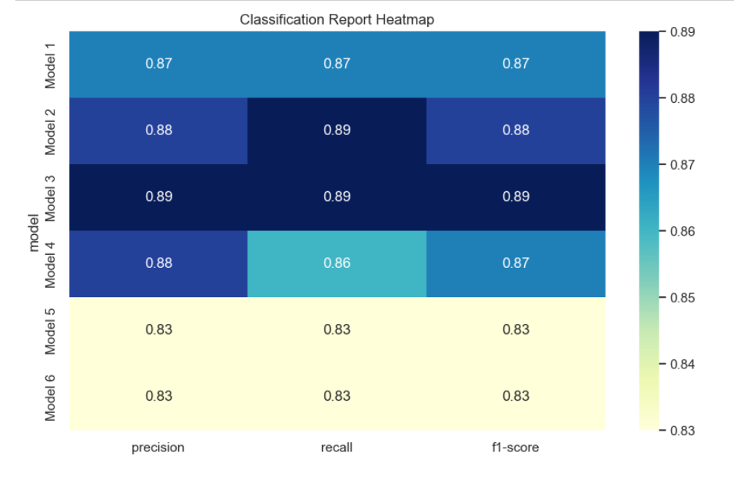
EVALUATION
Print the macro average metrics for the test dataset in a heatmap
Attempt 3 achieved the highest scores for all three metrics.
Median is less sensitive to outliers than mean
Removing outliers did not have a significant impact
Outliers in the data may not have had a significant impact

Slide 38
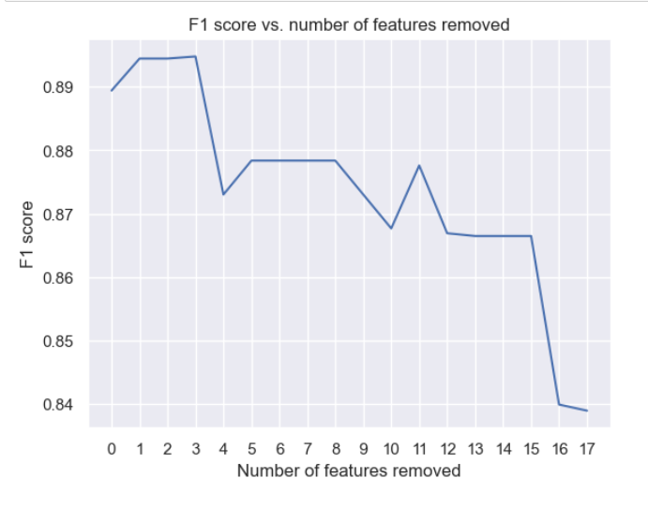
FEATURE PRUNING
Find the most useful features using the model from Attempt 3
Remove features used for regression one-by-one
F1 Score plotted after each feature was removed
2 distinct drops in accuracy
Age and Sex_M
Preceding factors are all important
Important Factors:
Age, Sex_M, ST_Slope_Up, ST_Slope_Flat, ChestPainType_ASY, ExerciseAngina_Y and Oldpeak

Slide 39
07
State Vector Machine

Slide 40
WHAT IS SVM
BASICS
HYPERPLANE
Machine learning algorithms used for classification
The decision boundary that separates the two classes
SUPPORT VECTORS
MARGIN
Data points that are closest to the hyperplane
Distance from the boundary line to the support vectors

Slide 41
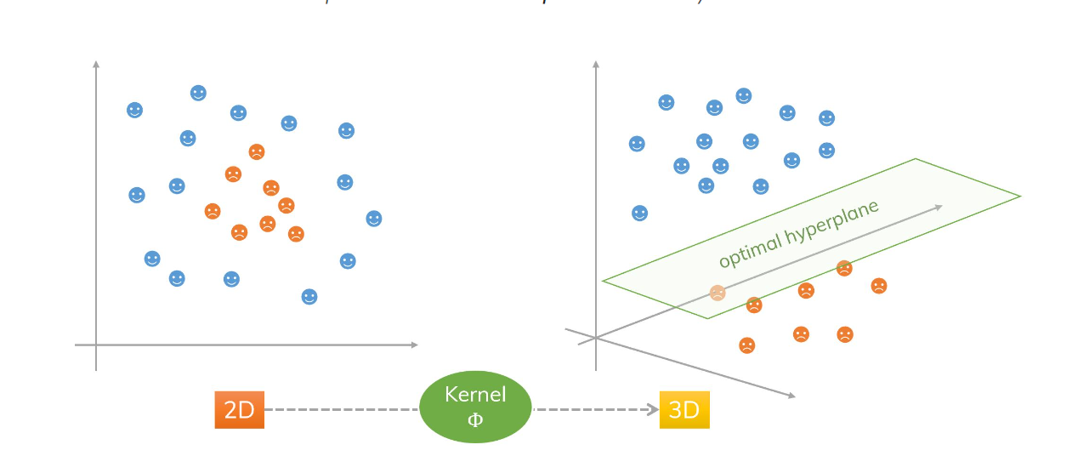
UNSTRUCTURED DATASETS
DIFFICULTY
KERNEL TRICK
SOLUTION
When considering multiple datasets to make a prediction it might be tough to view them in a single plane
SVM ‘kernel trick’ transforms 2D datasets into a higher dimension (e.g. 2D to 3D)
This converts non-linear problems into linear ones and allows for classification

Slide 42
WHAT DOES THE MODEL DO?
INPUT
OUTPUT
6 Datasets with varying Imputation and Outlier presence
Classification Report
(Recall, Precision, F1-Score)
HYPERPARAMETERS
SVM FIT
C value
Kernel Function
Gamma
SVM draw best decision boundary based off hyperparameter tuning

Slide 43
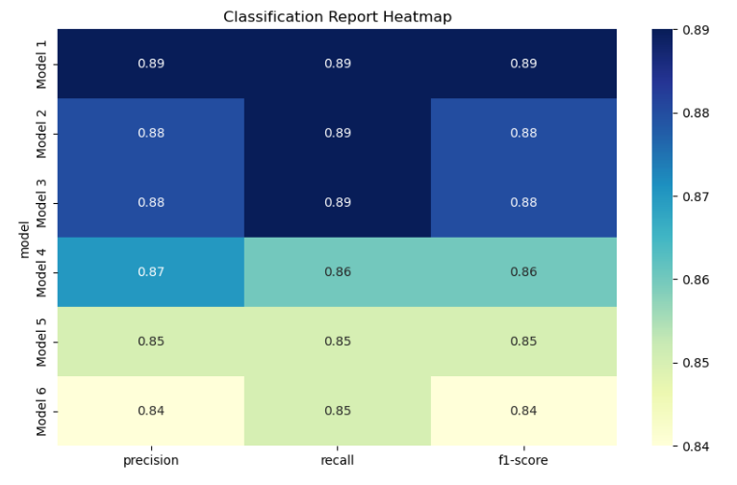
FINDING THE BEST MODEL
Print the macro average metrics for the test dataset in a heatmap
Model 1 achieved the best metrics
We ignore models 1 and 4 as SVM can be increasingly sensitive to outliers
Chose models 2 and 3 as they have a relatively small number of outliers
Compare between model 2 and 3

Slide 44
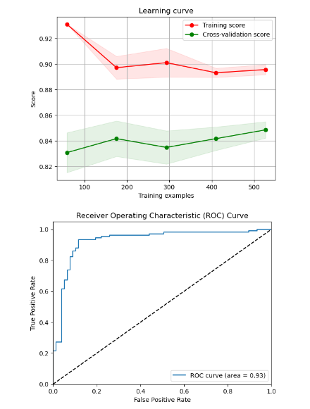
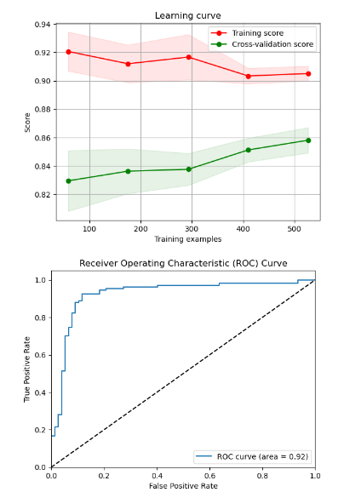
Learning Curve & ROC-AUC
Evaluate based on Learning Curves and ROC-AUC
ROC-AUC helps evaluate the performance of classification models, such as SVM
Graphical representation of how well the model is able to distinguish between the positive and negative examples
Model 2 is marginally better
Slightly better learning curve performance
Higher ROC-AUC score of 0.9279 (v.s 0.9245)
MODEL 2
Mean Imputation with outliers
MODEL 3
Median Imputation with outliers

Slide 45
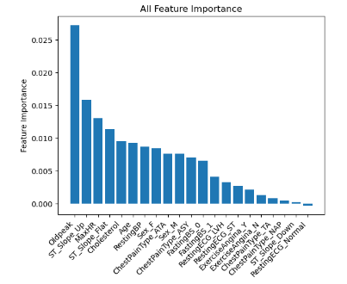
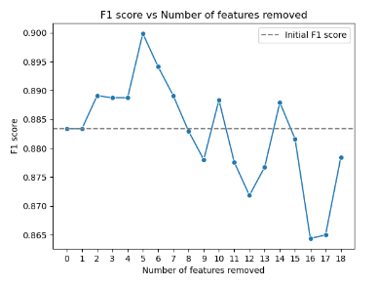
Feature Pruning
Permutation importance is a feature importance measure that works well with non-linear models like SVM, even when the kernel is not linear.
Oldpeak, ST_Slope_Up and MaxHR seem to be the top three variables
No discernable trend also graph is generally decreasing
Significant change when 'ChestPainType_ASY' when and 'Sex_F' are removed
ChestPainType_ASY, Sex_F, Oldpeak, ExerciseAngina_N and ST_Slope_Up are the most important variables

Slide 46
08
CONCLUSION

Slide 47
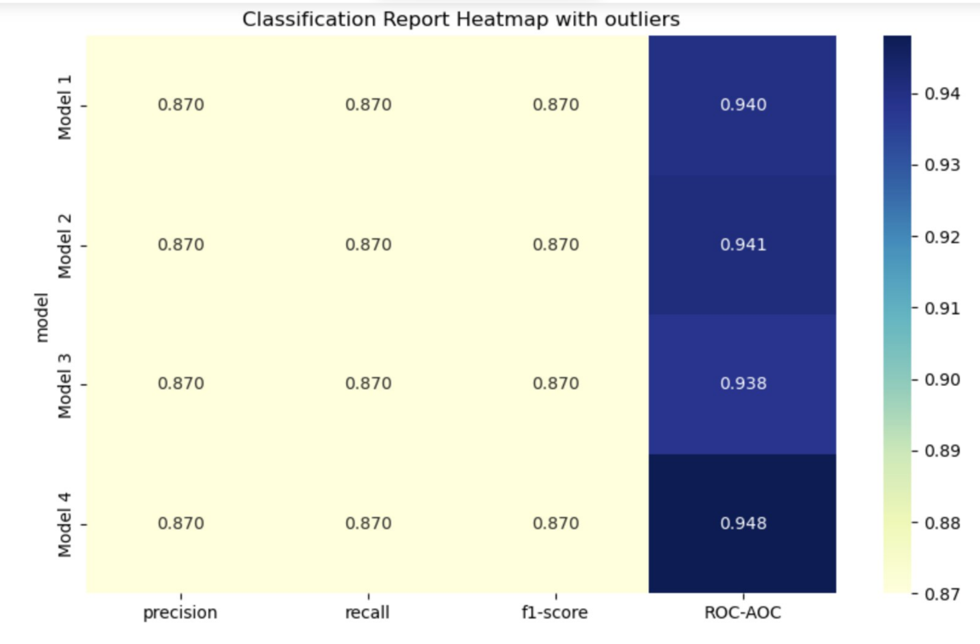
FINDING THE BEST CLASSIFICATION STRATEGY
Comparing Models 1 - 4 (Random Forest, Decision Tree, Logistic Regression and SVM respectively)
SVM (Model 4) best model with highest ROC-AUC score of 0.948

Slide 48
MOST IMPORTANT FEATURES
ChestPainType_ASY
ST_Slope_Up
ExerciseAngina_N
Asymptomatic Chest Pain seems to be one of the best indicators of Heart Disease
An upward ST Slope is a key indicator of Heart Disease
Those with no exercise angina seem to be more susceptible to Heart Disease
Sex_F
Oldpeak
Our models reveal that Females have a higher chance of Heart Disease
Oldpeak (or ST Depression) commonly occurs as an important feature

Slide 49
EVALUATION
Our findings are limited to our dataset and may not be always applicable to the real world
No indication that one gender is significantly more likely to develop Heart Disease than the other
Exercise Angina is an indicator of heart disease
However, indicators like ST_Slope_Up and Oldpeak are consistent with medical literature
ST segment elevation can indicate acute heart diseases
Higher values of oldpeak are associated with severe heart diseases

Slide 50
THANKS!
Please keep this slide for attribution

